Slide 1


Slide 2


Slide 3


Slide 4
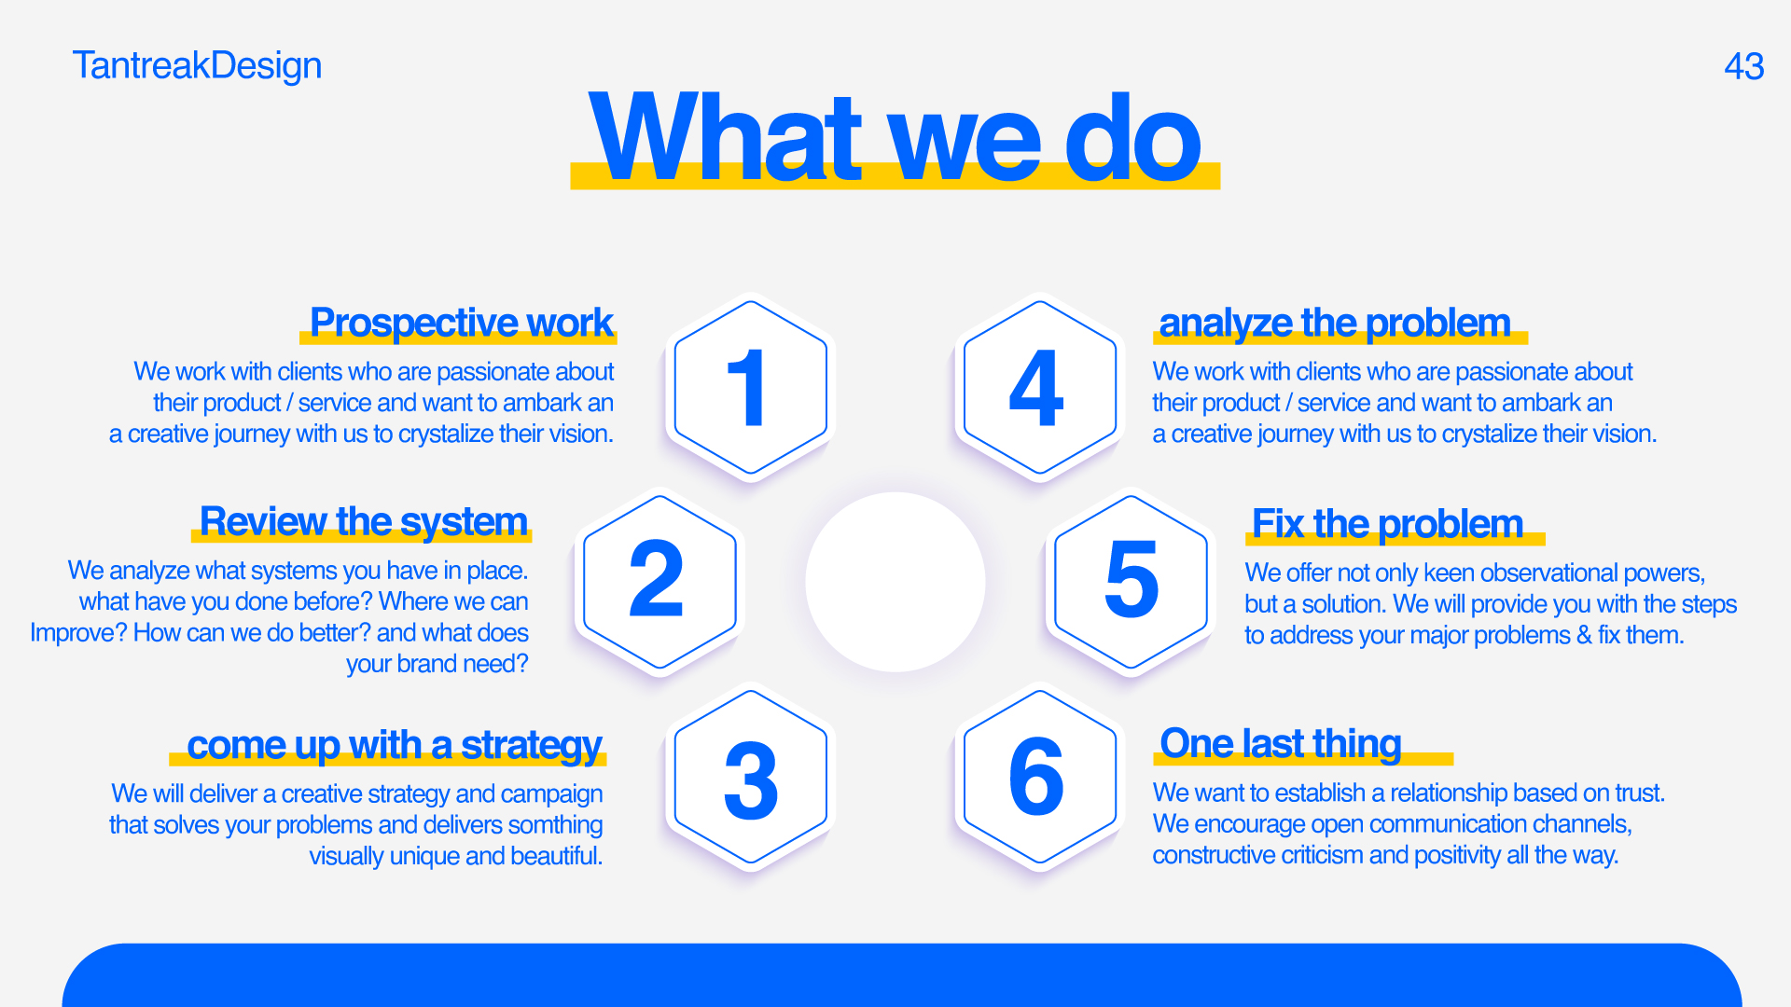

Slide 5
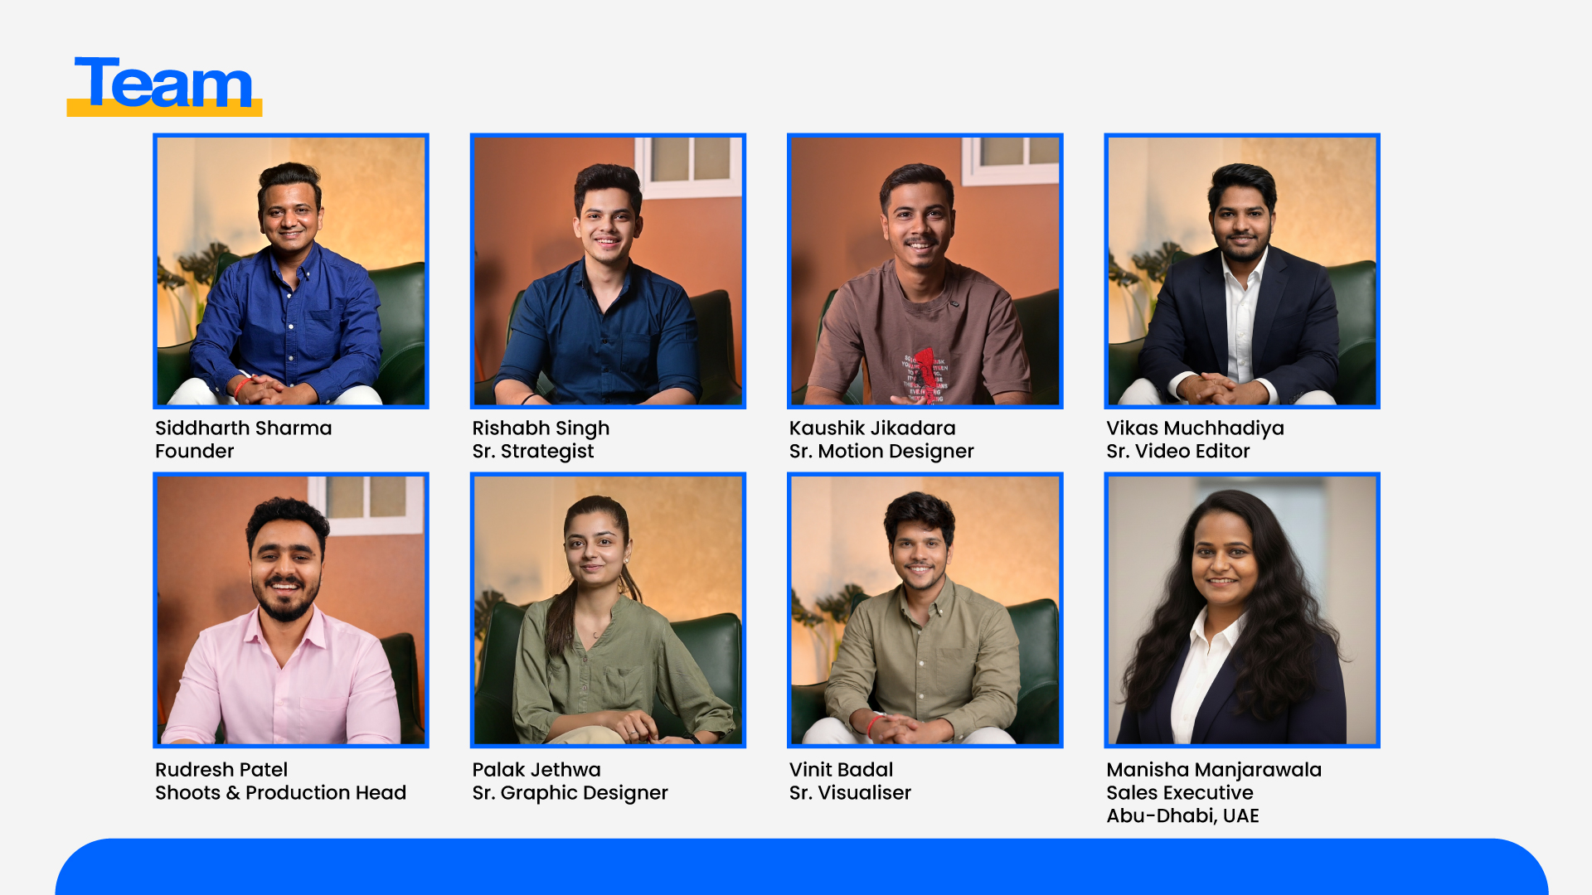

Slide 6

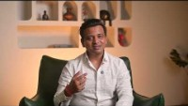


Message From Founder
Our Strength As a Team
Our Team Expertise

Slide 7


Slide 8
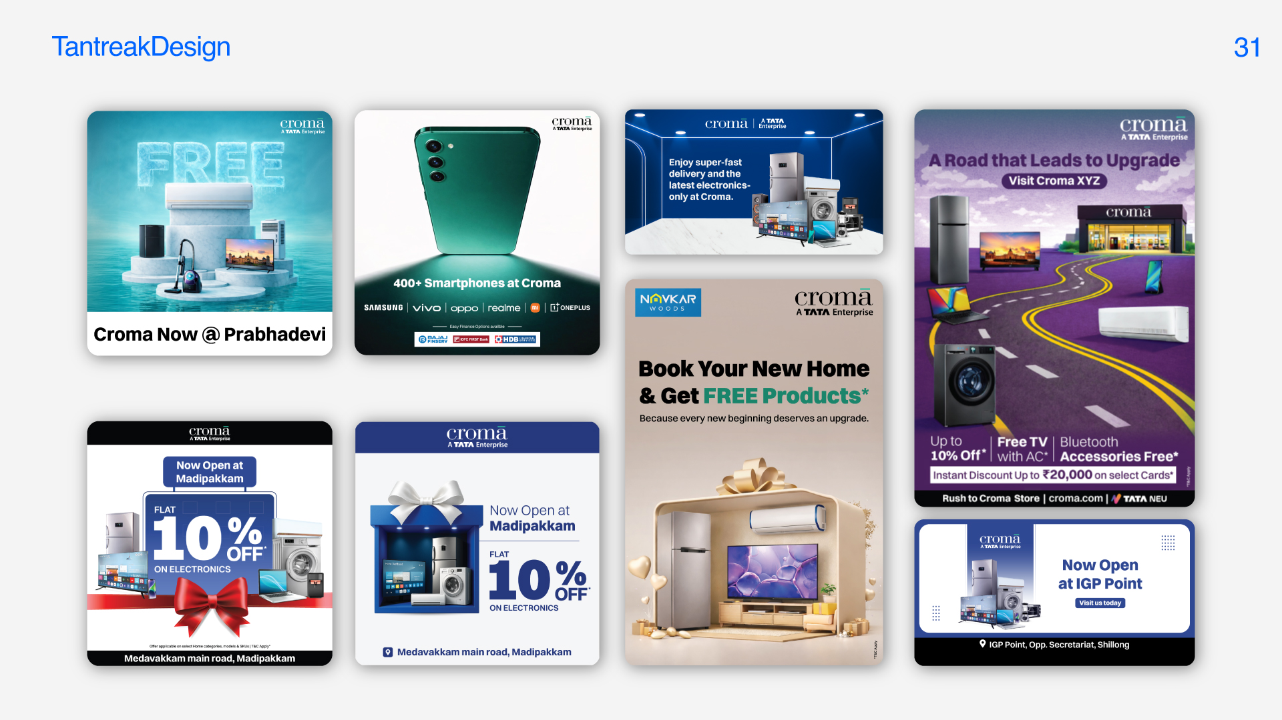

Slide 9


Slide 10
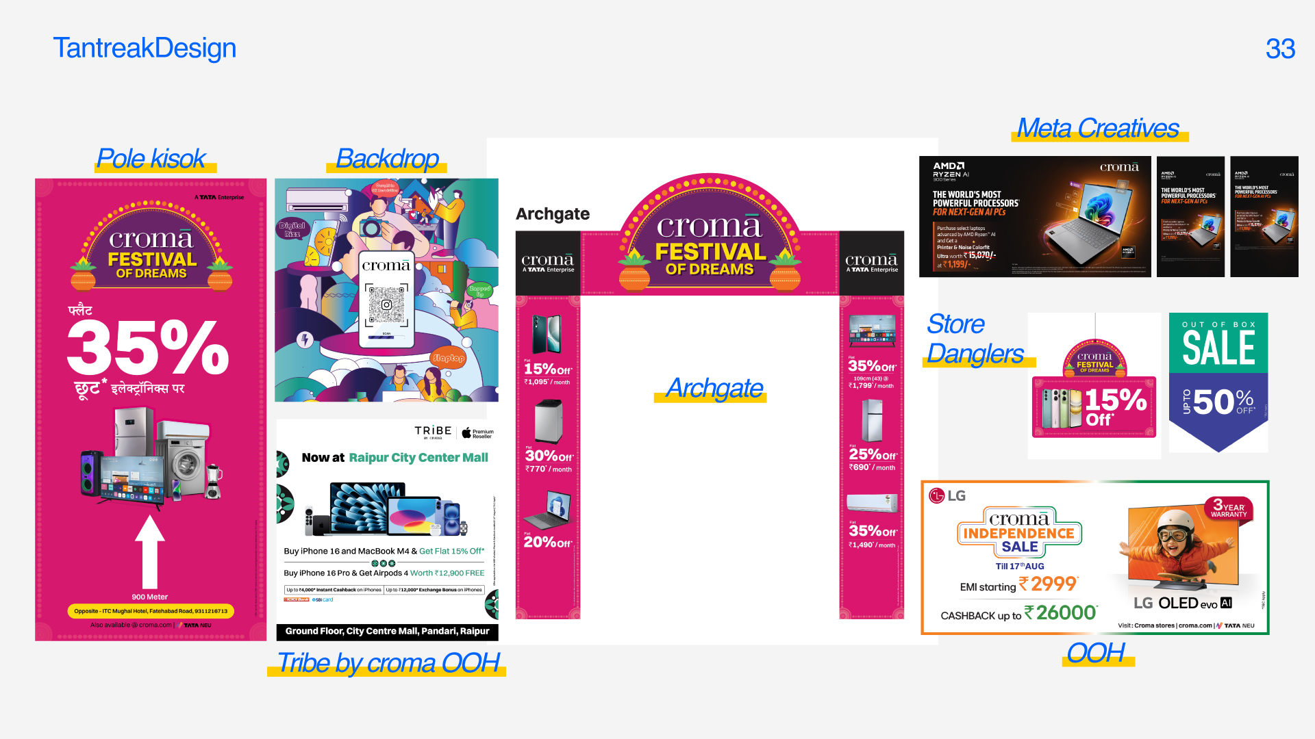

Slide 11


Slide 12


Slide 13


Slide 14


Slide 15


Slide 16


Slide 17


Slide 18


Slide 19
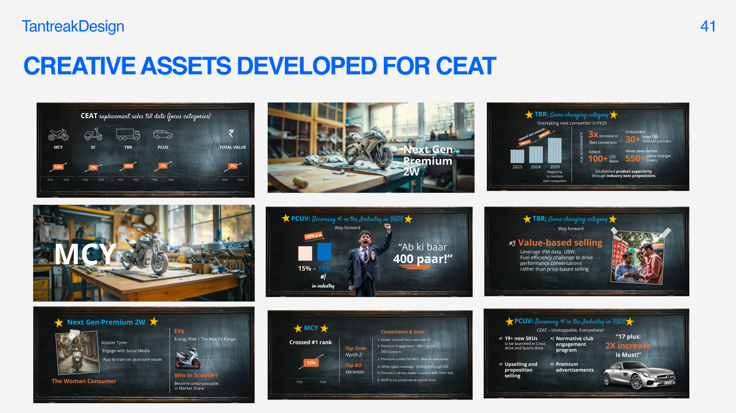

Slide 20
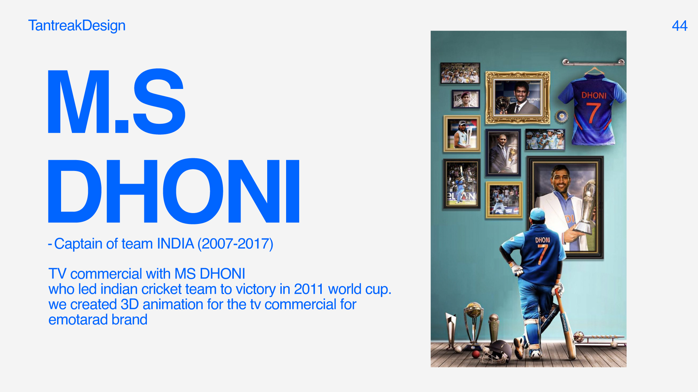

Slide 21
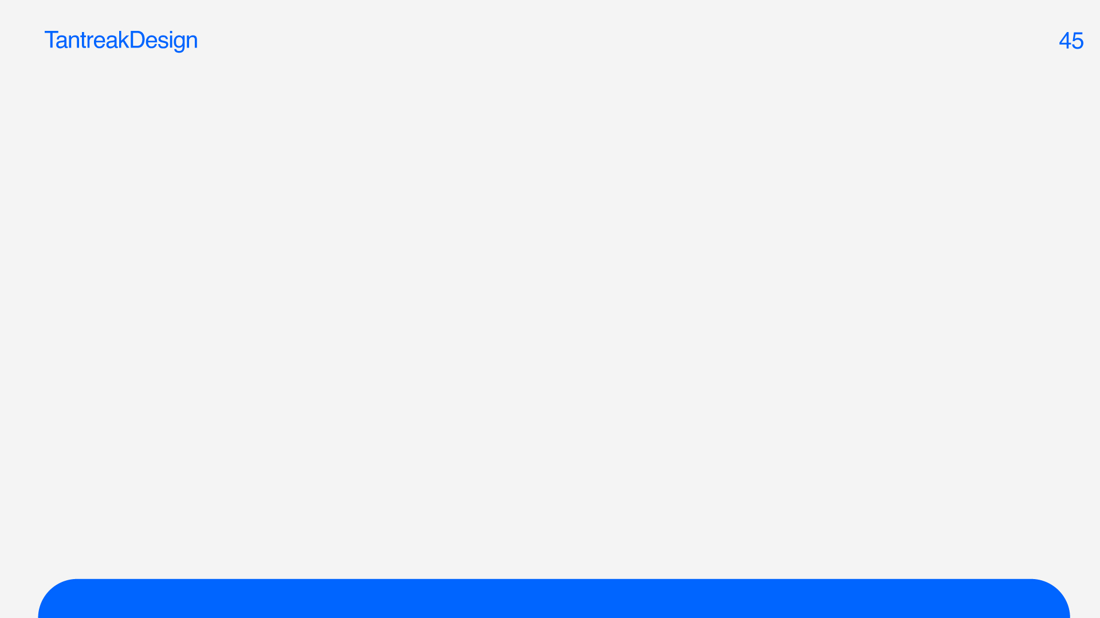



Slide 22


Slide 23
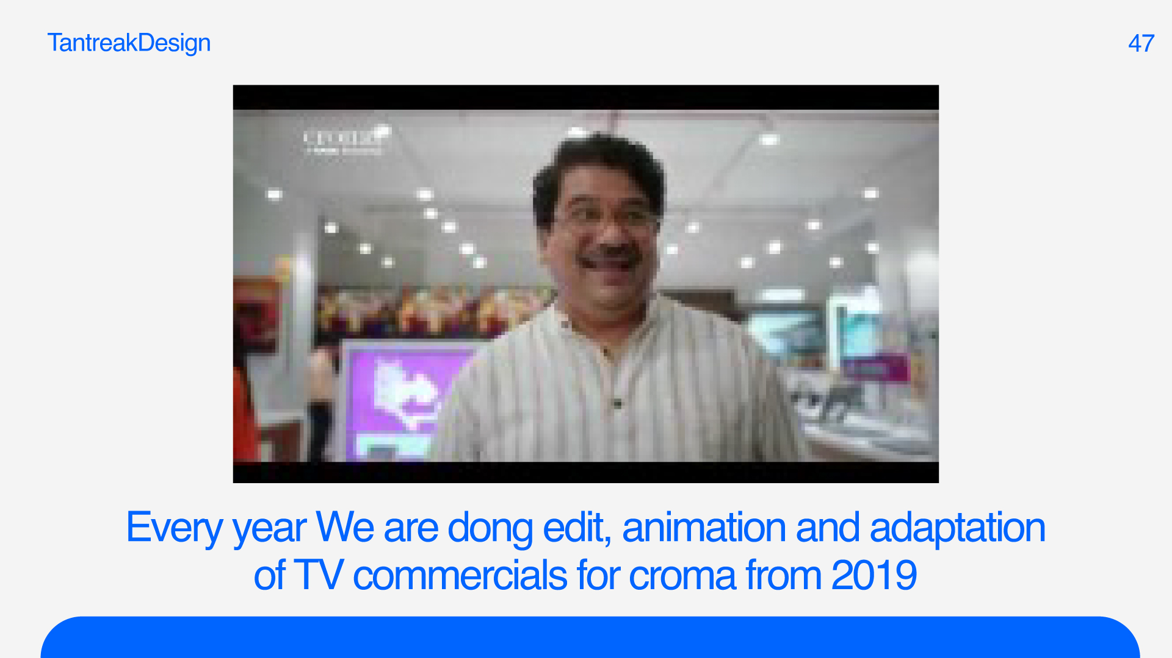
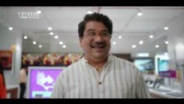

Slide 24
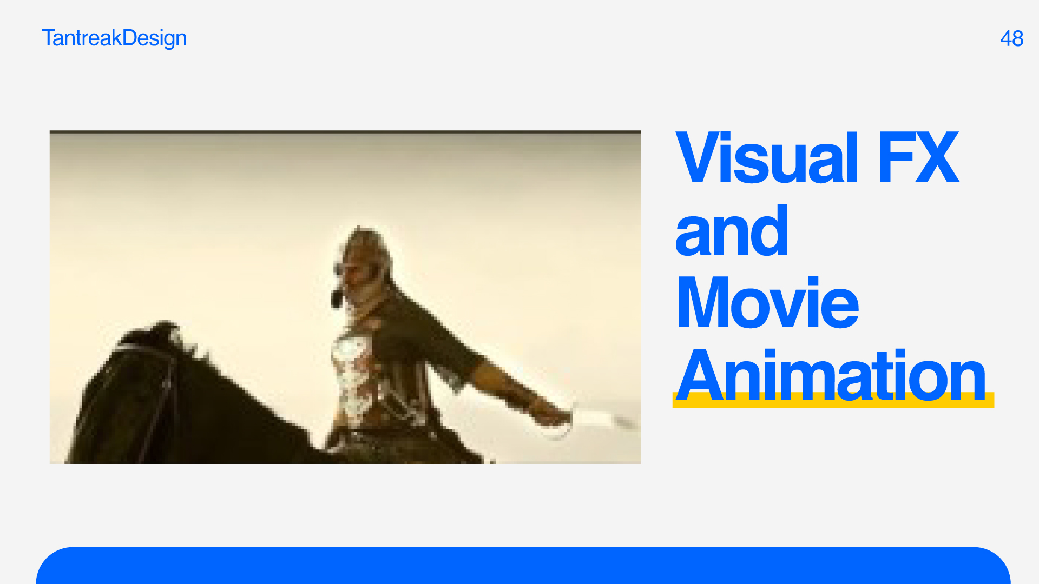
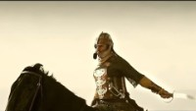

Slide 25







Slide 26




Slide 27


Slide 28


Slide 29


Slide 30


Slide 31


Slide 32


Slide 33


Slide 34


